Slide 1

Final PROJECT
2 Ideas Pitch

Slide 2
Our Team
Even Xu
Tanav Sharma
Bryan K
Keith McManamen
Juanita Camargo

Slide 3
The knowns and the unknowns
Timeline: 5 weeks
Requirements:
Database
Programing language
Visualizations
Front end
Machine learning model
Forms of analytics
The big Q. which idea will meet #1 and #2 above?
The next big Q. is: What are the major milestones to make it happen?

Slide 4
Idea 1: THE ROAD TRIP ASSISTANT DESIGNER
What if you had the option to have an intelligent tourism agent a click away through your browser where you simply input the 1 country you want to road trip through, the amount of days and the 3 themes you want to tackle during your journey? Travelling on a high, mid or low budget?, we will give you:
A drawn Road Trip, and,
Places to stay and places to visit
User Input
Data Processing
Road Trip Designed

Slide 5
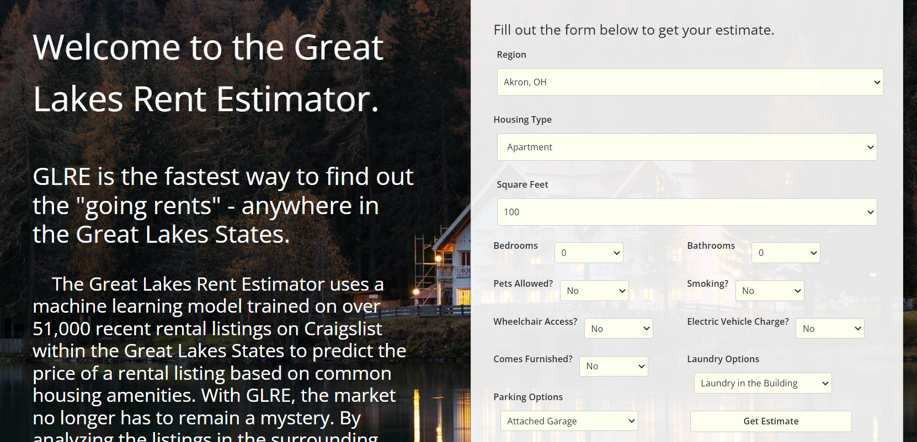

Slide 6
A quick glance of the data processing:
Data from:
Yelp
Trip Advisor
Use of Machine Learning (clustering to come up with the top 3 themes in the country)
Gmaps to draw the route, tableau to show what data is supporting the perfect road trip plan
JS and HTML for the front end and web development/design
Dynamo DB for unstructured data – from AWS – 25gb storage

Slide 7
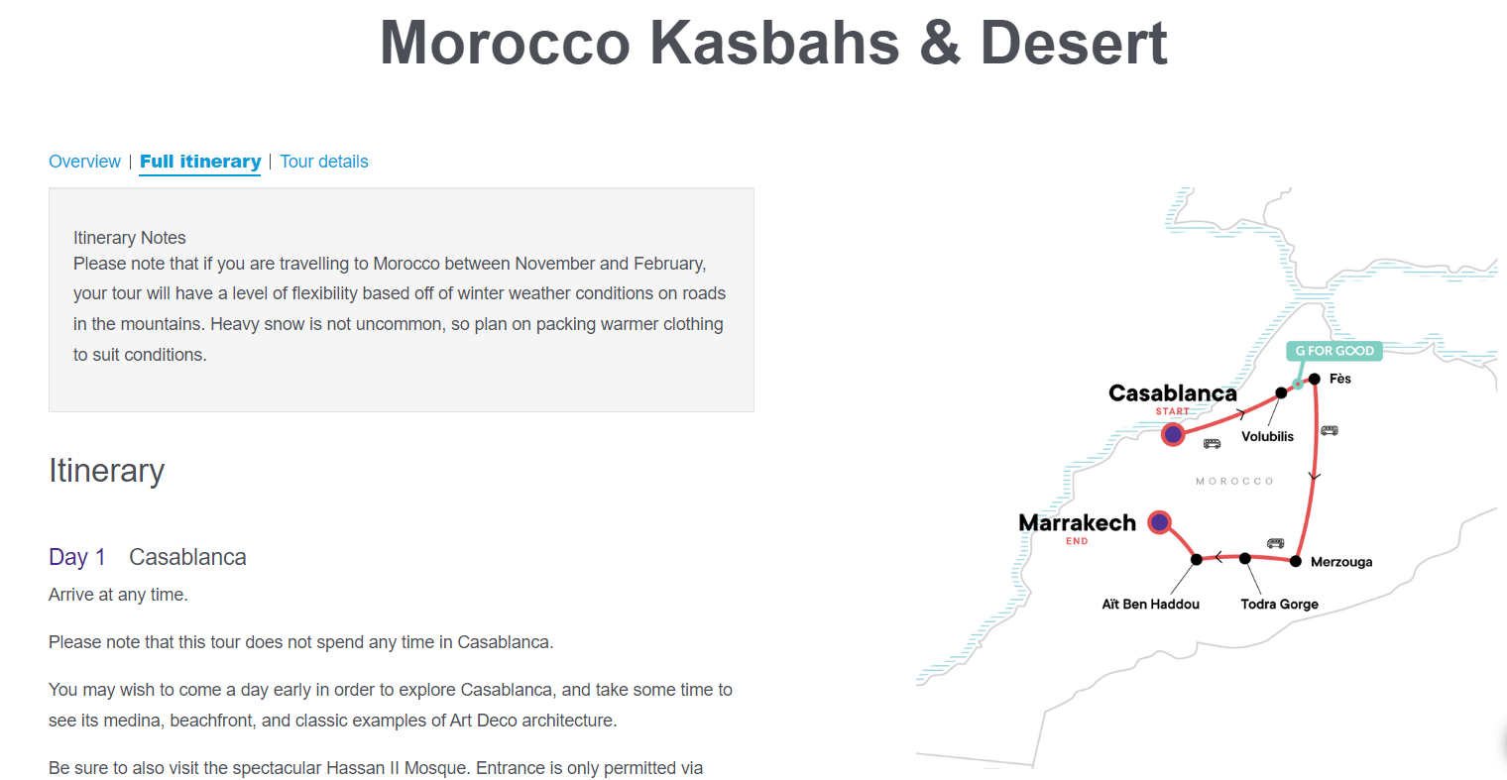

Slide 8
Idea 2: YOUR NEXT EV CAR PICKER
Your next car is an EV, however, this is an unexplored field and you are uncertain as to which car to pick, the only knowns are your budget, your top favourite car manufacturers and preferred colors. Our web app does the job for you answering the following:
1. what EV car to get (all specs being met)
2. which car dealer offers it in a given radius close to your home
3. and, by which date you can have it
User Input
Data Processing
The final EV car top 5 options ready to buy

Slide 10
A quick glance of the data processing:
Data from:
Car dealers top brands
Predict using machine learning - sales
JS and HTML for the front end and web development/design

Slide 11
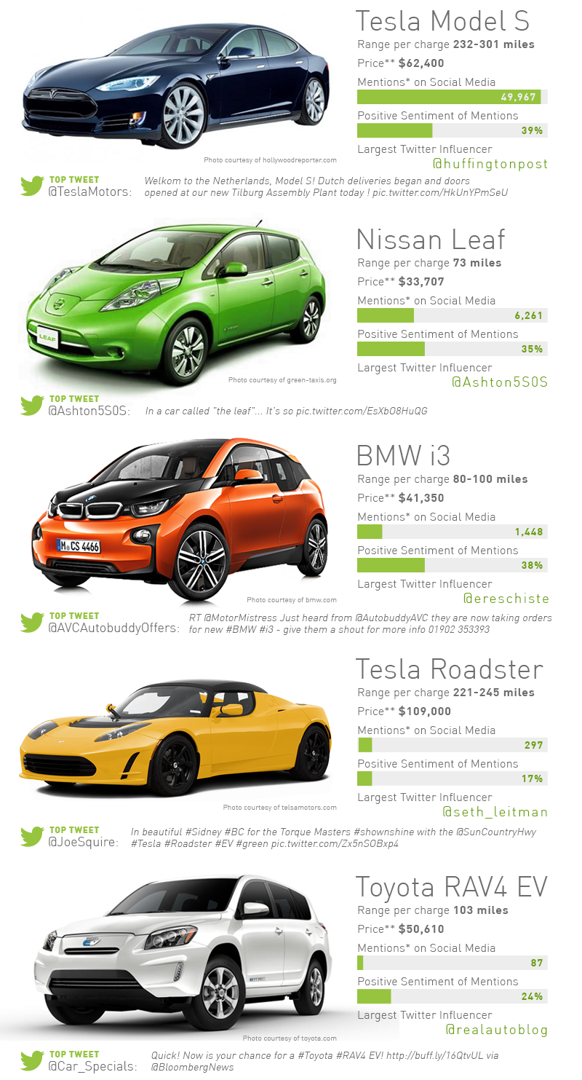

Slide 12
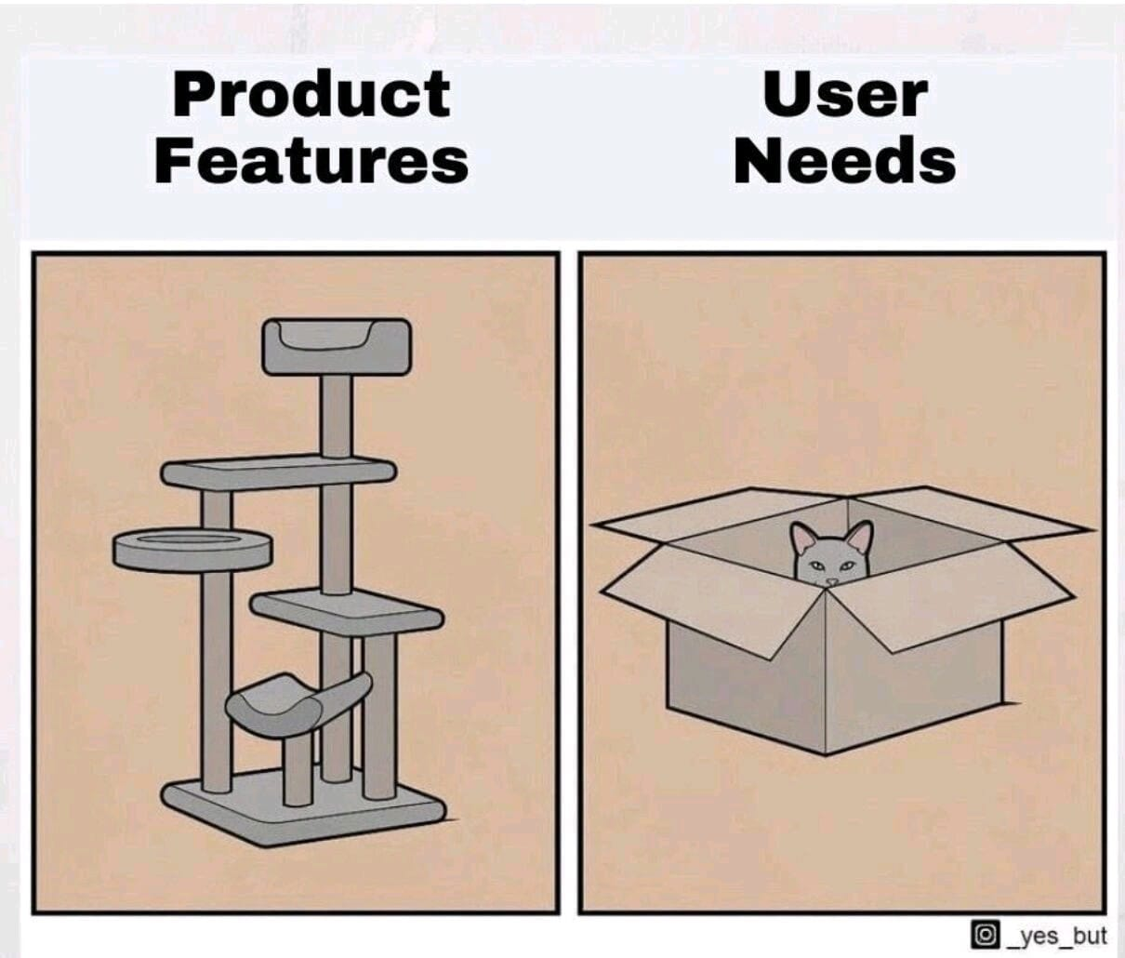
Our team likes meeting the user wishes

